Slide 1
SAINT-2 Serial Bus Interface Tool
Overview

Slide 2
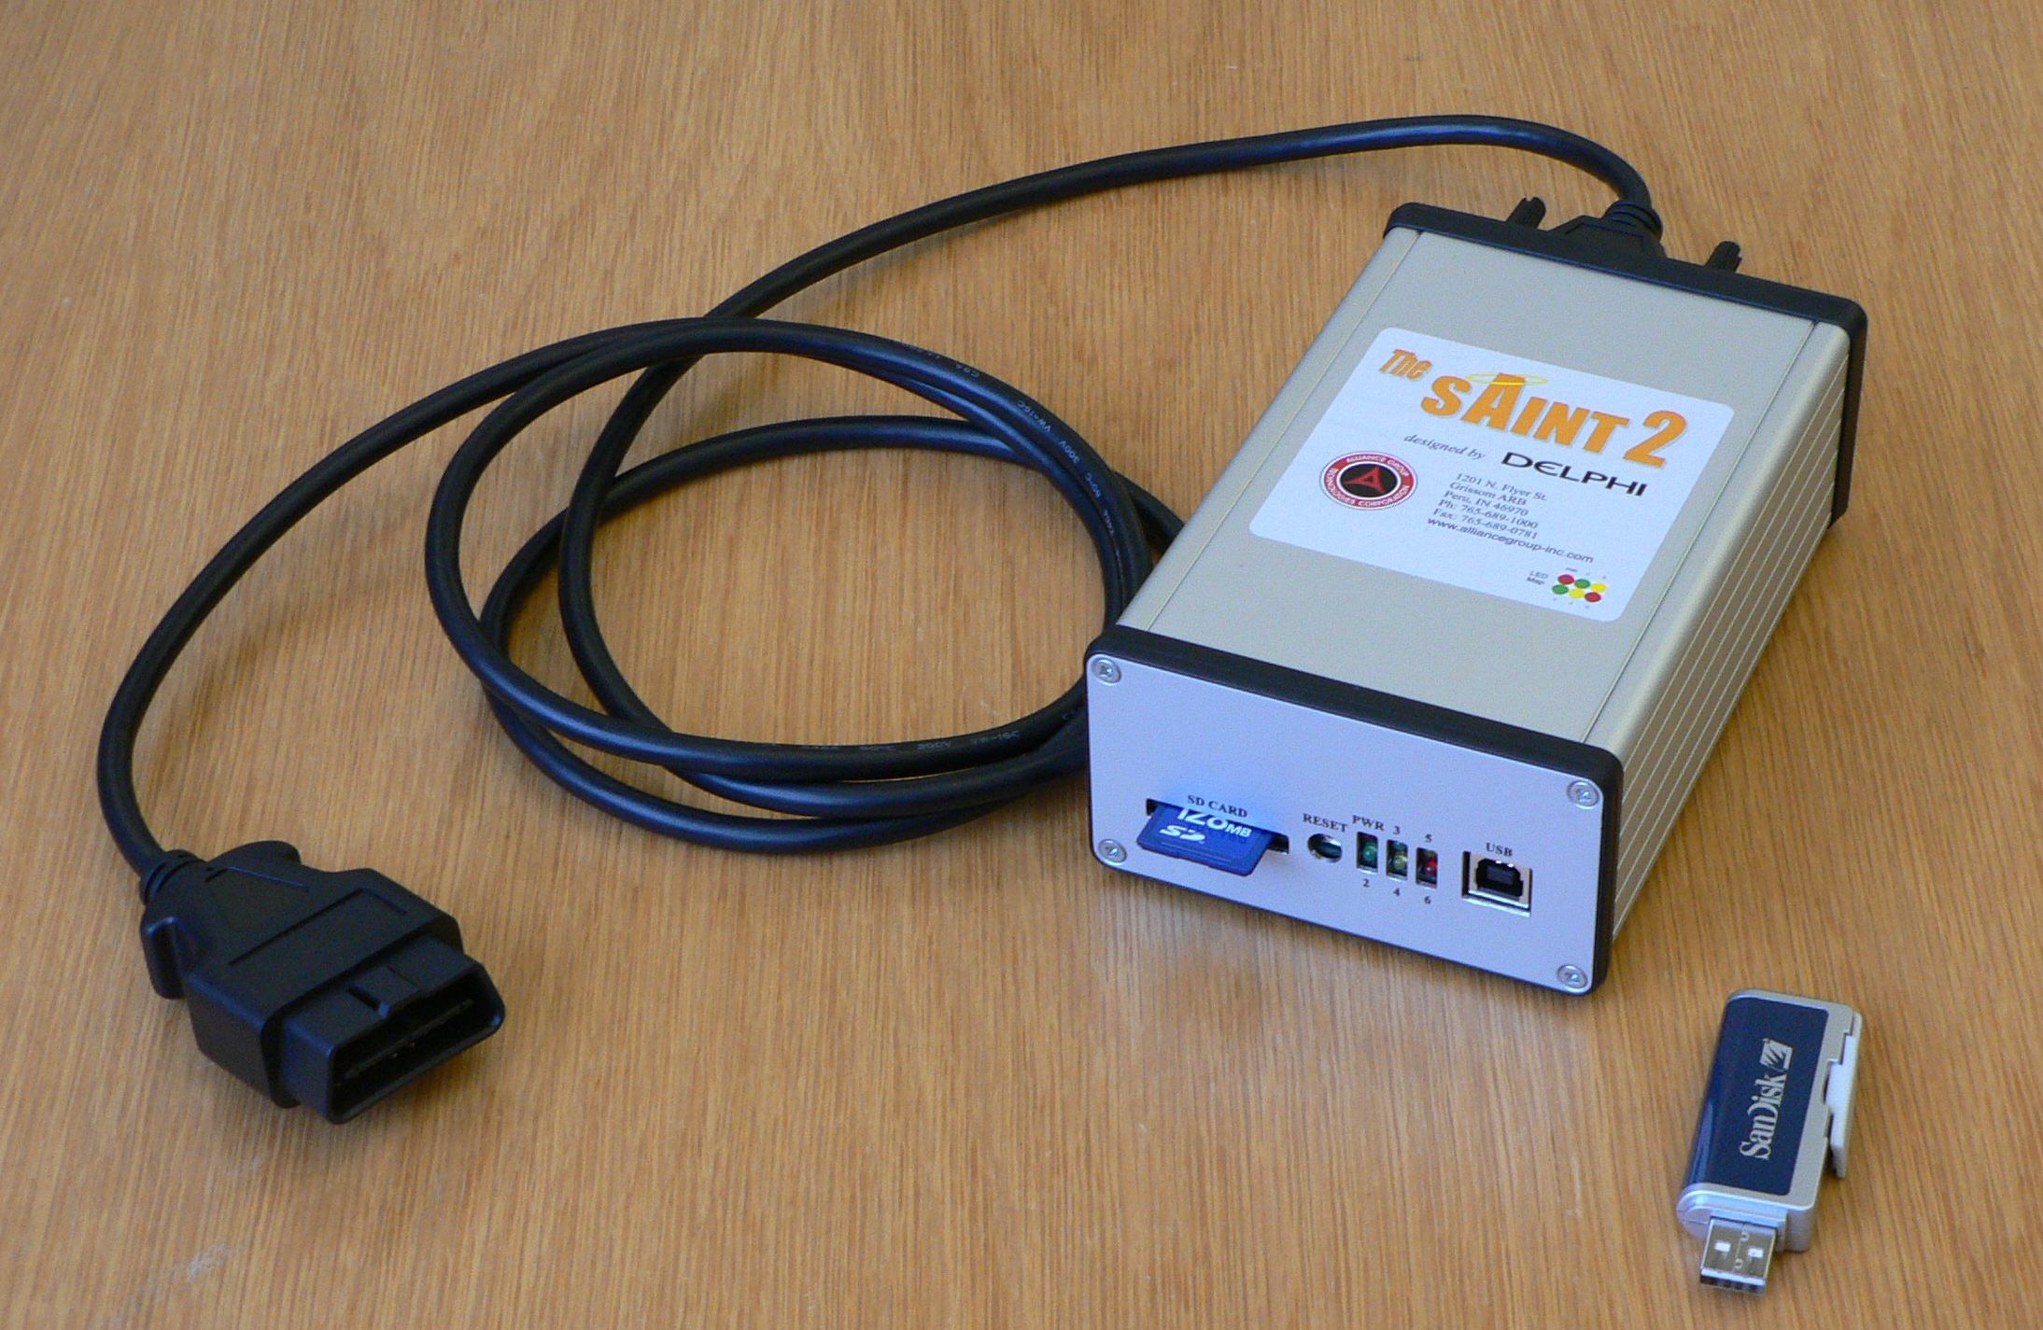
SAINT-2/3
Serial Bus Interface Tool
Stand-alone Re-flash Tool

Slide 3
Serial Bus Interface Tool – System Diagram
Purpose: To provide an interface to a serial bus for a user, a test application, or another controller

Slide 4
Serial Bus Interface Tool – General Features
User can interface with multiple buses concurrently with a single tool
Host interface is USB or RS232
The SAINT2/3 hardware is host and SD card configurable
The SAINT2/3 can be configured to send out periodic messages without a PC interface
The SAINT2/3 can be configured to act as a “gateway” between certain serial buses without a PC interface
The host can interface with discrete trigger out and trigger in pins

Slide 5

Serial Bus Interface Tool – Host Software
SAINT Bus Engine 2 (SBE2)
Provides the API for user interface or test application “plug-ins”
Is solely a pass-thru for serial messages – the smarts are in the “plug-ins”
Interfaces with the COM port or USB drivers
Provides the interface to re-flash the SAINT2 firmware over USB
“Plug-in”
Is a user interface or test application for the SAINT2 System
Multiple “plug-ins” can be used at the same time
Some general use “plug-ins” are being developed by the SAINT2 Team
“Plug-ins” can be developed for custom applications by the user
Templates are available on the SAINT2/3 website for Visual C++, C# and Visual Basic “plug-ins”
Many user created “plug-ins” are available on the SAINT2/3 website
Note – Contact the author of the “plug-in” for help. The SAINT2 team does not support the user created “plug-ins”
I need to change the powermode
These are SAINT2 formatting bytes
My powermode changed. I need to send the wheelspeed data.
This message is for CAN1
50 01 22 FF 12 23 45
50 01 22 FF FF12 23 45 FF 00
$122 FF 12 23 45
API
USB/RS232
CAN1
50 04 34 23 23 23 23
50 04 34 23 23 23 23 FF 00
$434 23 23 23 23
SBE2
controller
“plug-in”
I received a message containing wheelspeed data. I need to update my display.

Slide 6
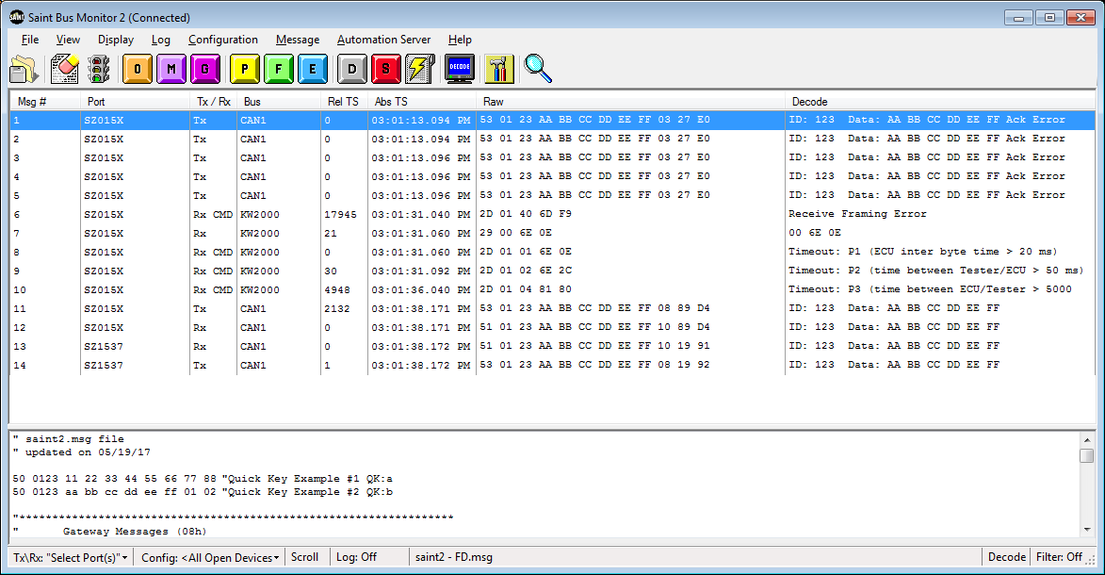
Serial Bus Interface Tool – SAINT “plug-ins”
SAINT2 Bus Monitor 2 (SBM2)
Displays serial bus messages in streaming list format
Allows user to send and receive serial bus messages
Provides message logging, filtering, emulation, scripting, etc…

Slide 7
Serial Bus Interface Tool – Protocols
CAN
Transmits and receives CAN on two independent nodes
Each node can be configured to support HS CAN, SW CAN, Fault tolerant CAN with applicable baud rates up to 500K baud
CAN errors are identified and reported
A listen only mode is supported (no ACK, no active error frames)
Ack error retries may be limited
CANFD
Saint3 only
KW2000
IIC
LIN
SPI (monitor only)

Slide 8
ISO 15765-2
ISO 15765-2 (Network Layer)
First Frame
Flow Control
Consecutive Frames
CAN
4k-1 message bytes
CANFD
4 GB-1, 2^32 -1 message bytes
Transparent to User
Message block treated as regular message
8 data byte CAN message
64 byte CANFD message

Slide 9
Saint 3
Saint 3
2 Versions
Adds CANFD
Saint 3 Pro
Saint2 with addition of CANFD
Pin Compatible
Same Harness
Saint 3 Micro
CAN and CANFD only
Similar to Intrepid ValueCAN
No SD card
No Stand-alone capability
Cost Effective
Same DB9 as Vector tools

Slide 10
Standalone Re-flash Tool – System Diagram
Purpose: Execute a process to re-flash software into a controller over the serial bus without using a PC.
Re-flash Set Up
PC → SD card using an SD card reader
Application, Calibration, or Routine files in binary format
Re-flash instructions – “SCRIPT.TXT” – tells the SAINT2 how to reflash your specific controller
Re-flash
Insert SD card into SAINT2
Connect to power/serial bus
SAINT2 LEDs indicate status and pass/fail result

Slide 11
Standalone Re-flash Tool – General Features
No PC interface is required during the re-flash procedure
The SAINT2/3 is powered through the ALDL cable from vehicle battery
The SD card contains all the software and instructions for the re-flash
Supports certain download strategies for many OEMs
The LEDs on the SAINT2 display the re-flash status and result
A summary file containing VIN numbers, the re-flash result and other custom information is updated on the SD card during every re-flash event
Automates diagnostic features to allow conditional re-flash or re-flash verification

Slide 12
Reference
http://sdt52.usinkok.northamerica.delphiauto.net/wiki/index.php/SAINT2:Documentation
http://sdt52.usinkok.northamerica.delphiauto.net/saint-tools/files/download/saint2/Documentation/SAINT_Programmers_Ref.pdf

